Slide 1




BUILD YOUR BRAND
A Beginner’s Guide to Social Media Presence for Entrepreneurs

Slide 2


1
2
Social Media Basics & Why It Matters
Shaping Your Brand
AGENDA
3
4
Creating a Social Media Presence From Scratch
Social Media Content Type
5
Effective Marketing Strategy
6
Q&A

Slide 3
1
Social Media Basics & Why It Matters

Slide 4
What is a brand?
Any ideas?

Slide 5

What is a brand?
Are these brands?

Slide 6
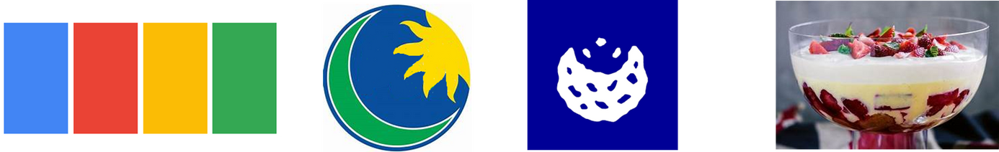
What is a brand?
What about these?

Slide 7

What is a brand?
And these?

Slide 8
What is a brand?
Name
Logo
Product Tagline Colors

Slide 9
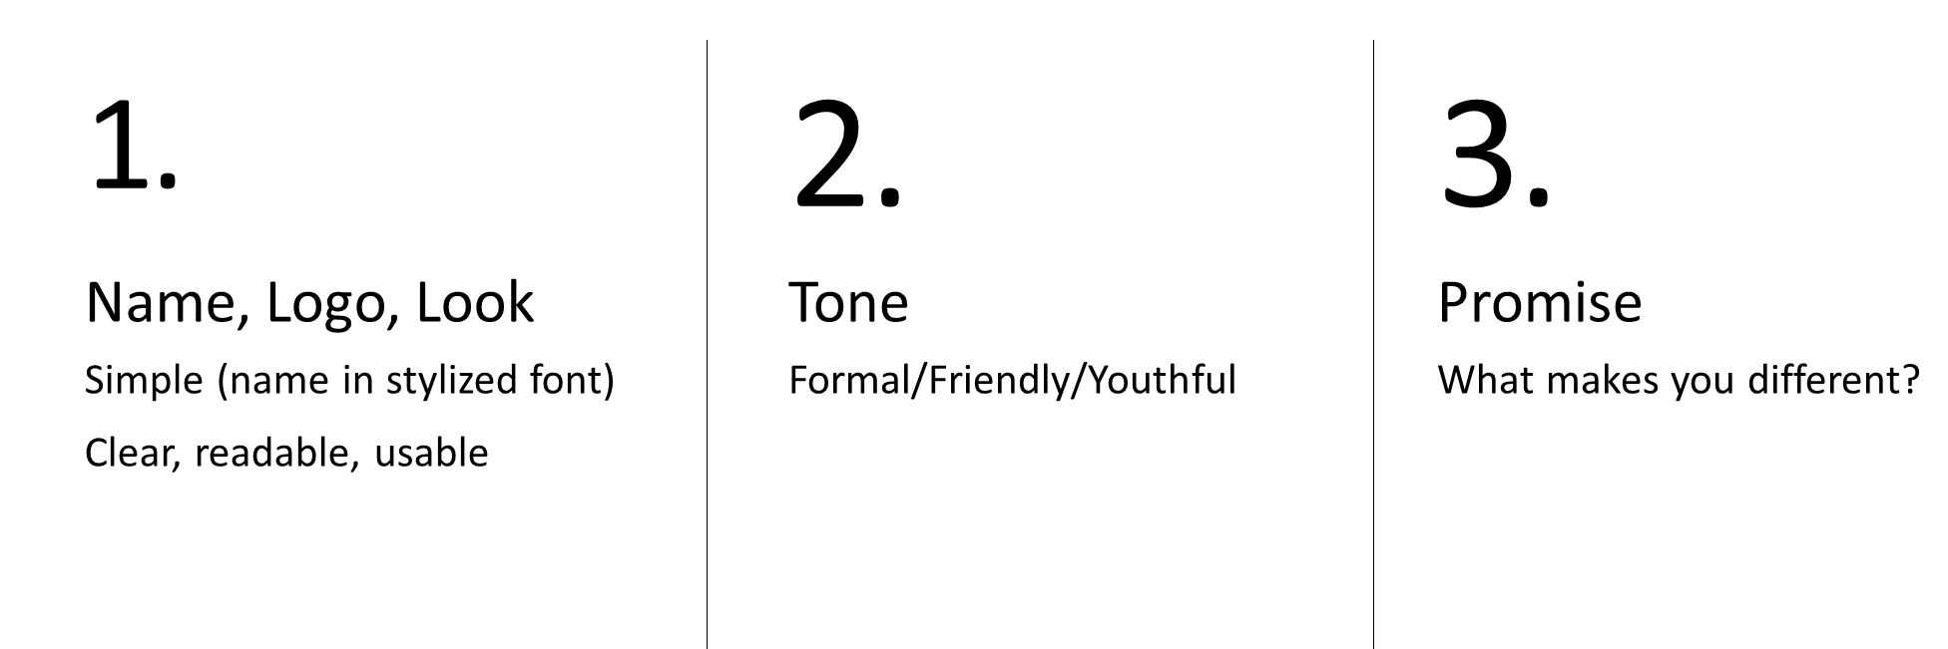
Notes:
What does usable mean?
Example of formal, friendly, youthful tones
Formal: “Kindly DM to place your order.”
Friendly: “DM karein, I’ll get back soon ♥️”
Examples of promises: Gluten free, organic, no harmful chemicals, sugar free

Slide 10
Your brand is not just what you post—it’s what people feel when they think of your business.

Slide 11
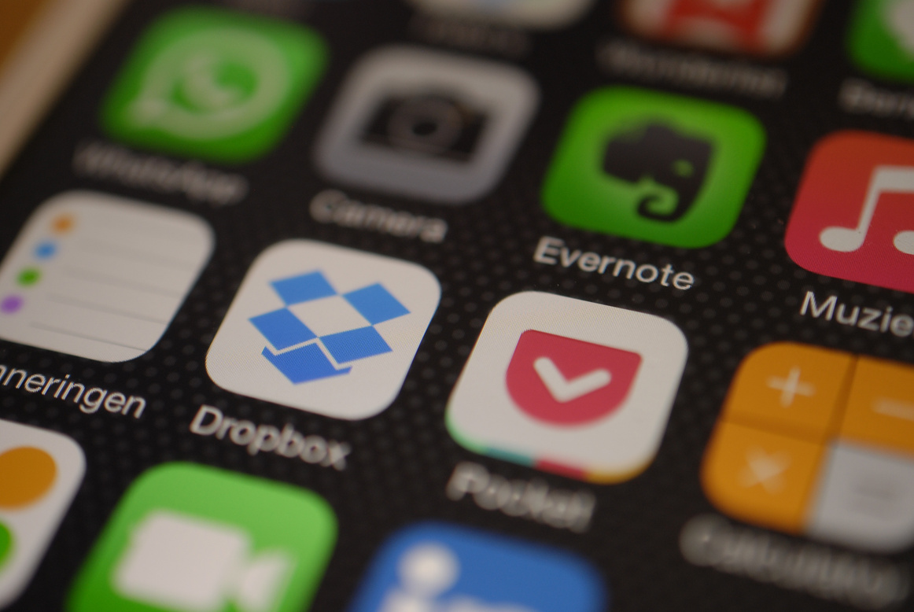
Why does it matter?
Global social media users: 4.86 billion
Pakistan: 71 million active users
Can you name any social media apps?
WhatsApp
Instagram: Fastest growing among youth and women
Facebook: 38M+ users
TikTok: Huge reach in small cities for visual content

Slide 12
Why does it matter?
Global social media users: 4.86 billion
Pakistan: 71 million active users
Can you name any social media apps?
WhatsApp
Instagram: Fastest growing among youth and women
Facebook
YouTube
WhatsApp
Instagram
TikTok
Snapchat
Pinterest
LinkedIn
Facebook: 38M+ users
TikTok: Huge reach in small cities for visual content

Slide 13
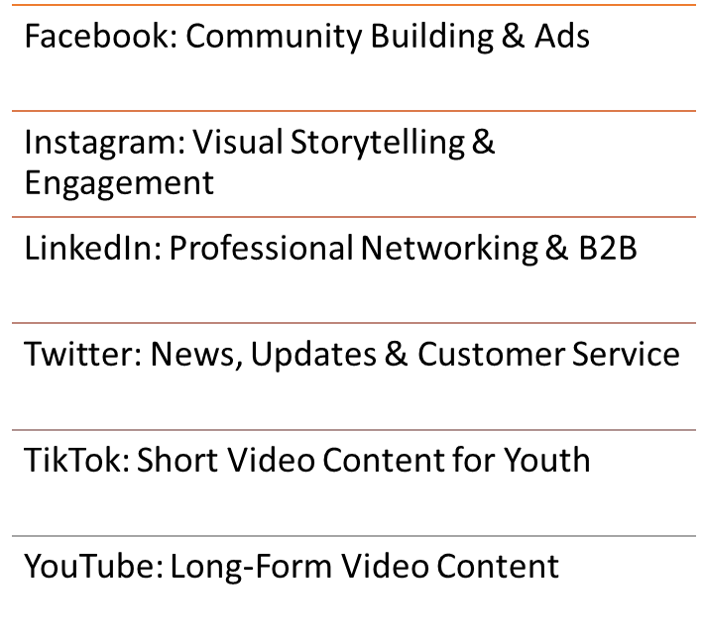
Which app is better for your business?

Slide 14

Which app is better for your business?
Know your target audience
Understand Your Business Type
Define Your Goals
Check Your Resources
Match Content Style with Platform

Slide 15
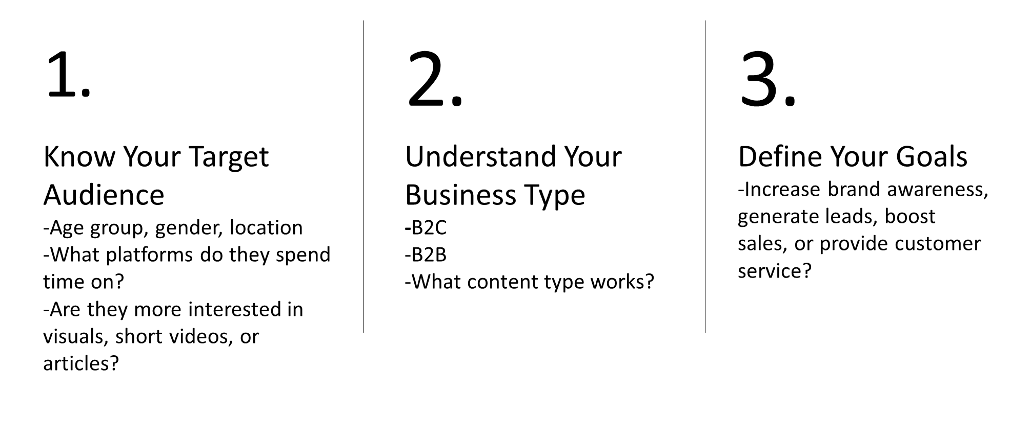
Notes:
B2C: visual and engaging content works best
Examples of B2C??
-Food, fashion, retail
B2B: professional, informative content is more effective
-consulting services
-raw materials
-supplying finished products to other B2C in bulk

Slide 16
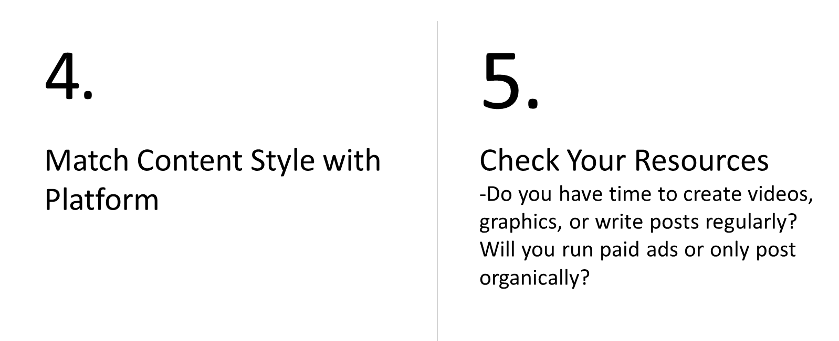
Notes:
Instagram: visual products, short videos, behind-the-scenes
Facebook: community building, events, ads for local targeting
LinkedIn: B2B networking, recruitment
YouTube: Tutorials, demkos, ong-form video content
X: Real-time updates, news
WhatsApp/Messenger: customer service, personalized communications
Pinterest: DIY, fahion, recipes, home decor

Slide 17
2
Shaping your brand

Slide 18
Step 1: Identify Your Business
What do you want to sell or promote?
Why do you want to start this business?
Step 2: Know Your Audience
Who are your ideal customers?
Where do they spend time online? (max 2)
Step 3: Define Your Digital Brand
What feeling do you want your brand to give people?
Example: friendly, fun, elegant, premium, comforting
What is one line you could write in your bio?
Step 4: Name your brand
Write 3 possible names for your business
Short, easy to say and easy to remember
Combo of your name + product (eg: Fatima’s Threads)
Avoid: Hard spellings or symbols or difficult to pronounce words

Slide 19
Prompt
I want to start a small business in Pakistan. I plan to sell ______ to _______. I want a brand name that is short, easy to remember, and preferably in English or a mix of Urdu and English. Please give me 10 business name ideas that sound local and friendly. Avoid anything too long or difficult to spell. Also suggest 3 Instagram username ideas that match the brand name.

Slide 20
Step 5: Design Your Look
Your profile picture could be a logo, a photo of your product or a picture of yourself
Create a logo
Create a cover photo
Create a logo:
canva.com/ai-logo-generator/
canva.com/s/templates
Aspect ratio: 1:1
Create a cover photo: canva.com/dream-lab
canva.com/s/templates
Use the suggested aspect ratio

Slide 21
Step 5: Design Your Look
Your profile picture could be a logo, a photo of your product or a picture of yourself
Create a logo
Create a cover photo
Step 6: Bio
Write a 1-line Instagram/Facebook bio:
Format: What you do/sell + For whom + Location + How to contact/order
“Homemade cakes in Lahore 🍰 DM to order 💌”
“Custom cakes 🍰 | Lahore | Order via DM 📩”
“Handmade khussas 👡 | Nationwide delivery | Tap link to order 👇”
Step 7 (OPTIONAL): Create your business-related Gmail address
You may use your personal Gmail account for now

Slide 22
3
Creating a Social Media Presence From Scratch

Slide 23
Facebook Page
Log into your personal Facebook account.
DON’T: create a new Facebook account
Create a Facebook page for your company:
Click on your profile picture on the top right with (menu ≡) -> ‘See more’ button -> Pages -> Create -> Professional -> Create a new page -> Add the page name -> Add category -> Create -> Add all the details
Desktop link: https://www.facebook.com/business/tools/facebook-pages/get-started/

Slide 24
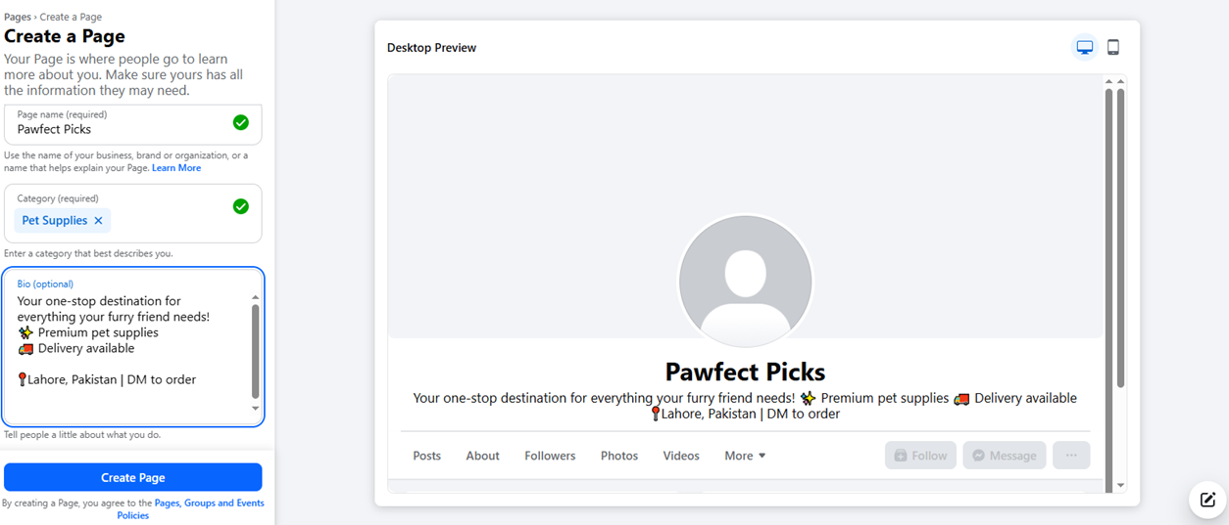

Slide 25
Instagram Business Page
Open instagram.com and click “Sign up”
Add profile picture and Bio
NOTE: Can only change to business profile on mobile
Click your profile picture and go to Settings (gear icon ⚙️ or the menu ≡)
In the search bar, type: Switch to professional account
Select Business (not “Creator”) and choose category (e.g., Bakery, Clothing, Artist)
Add your contact info (email, phone, WhatsApp if you want)

Slide 26
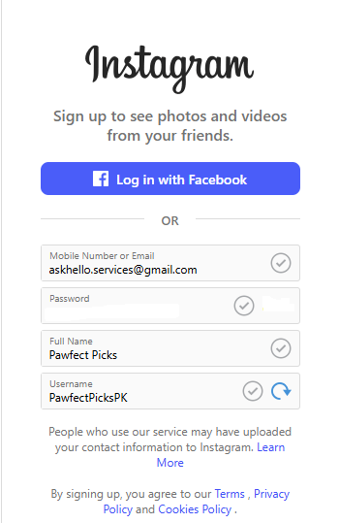
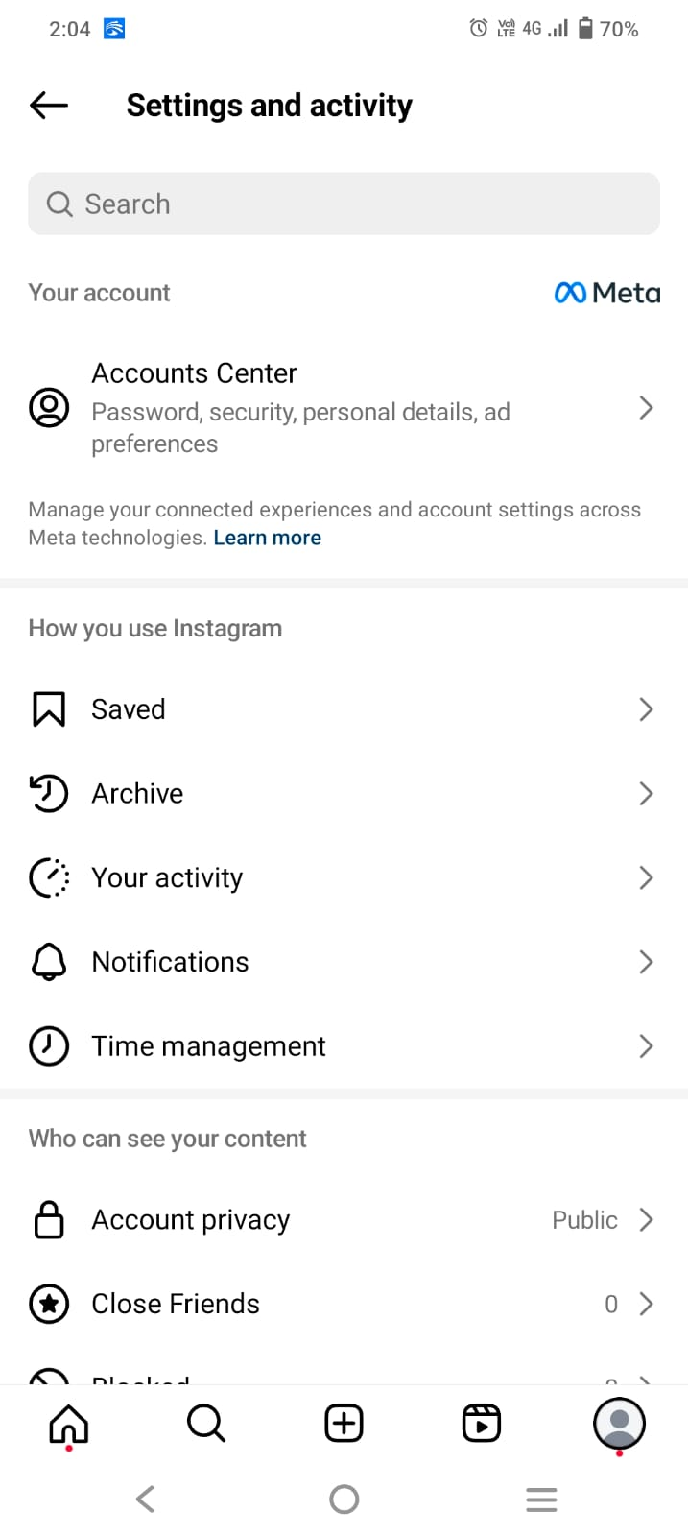
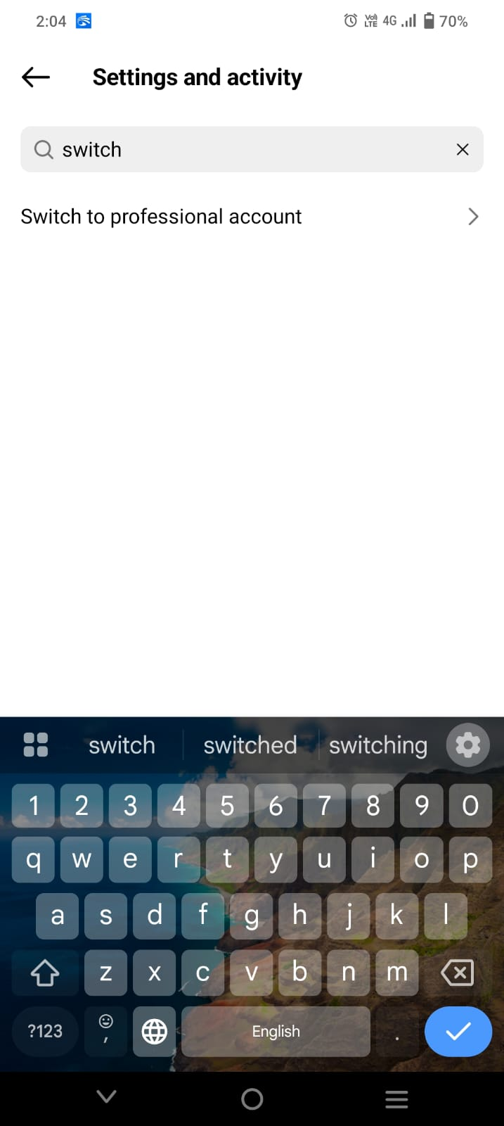
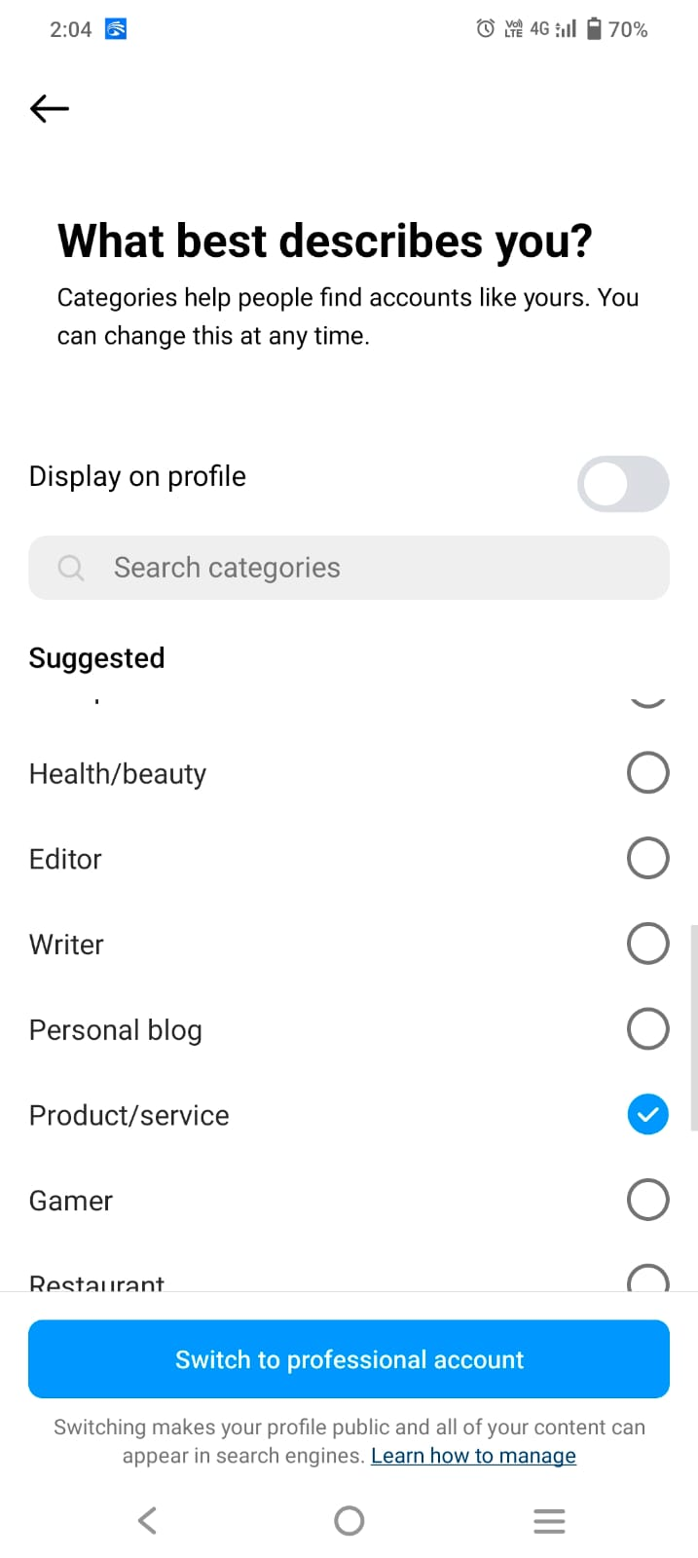
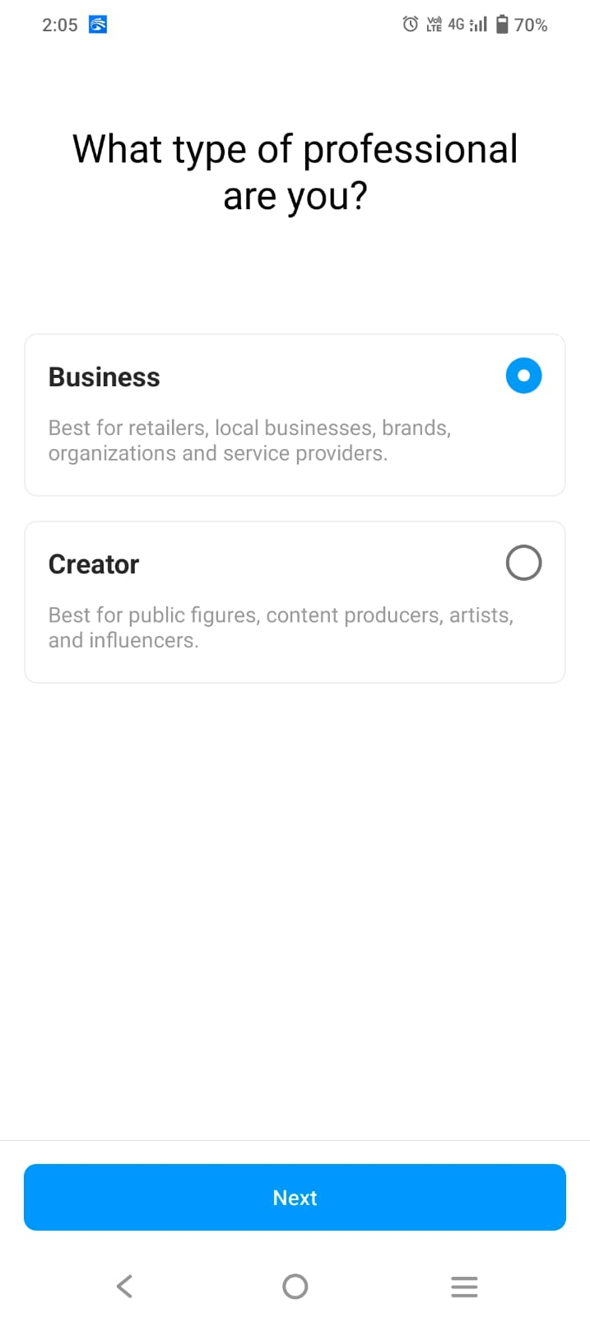
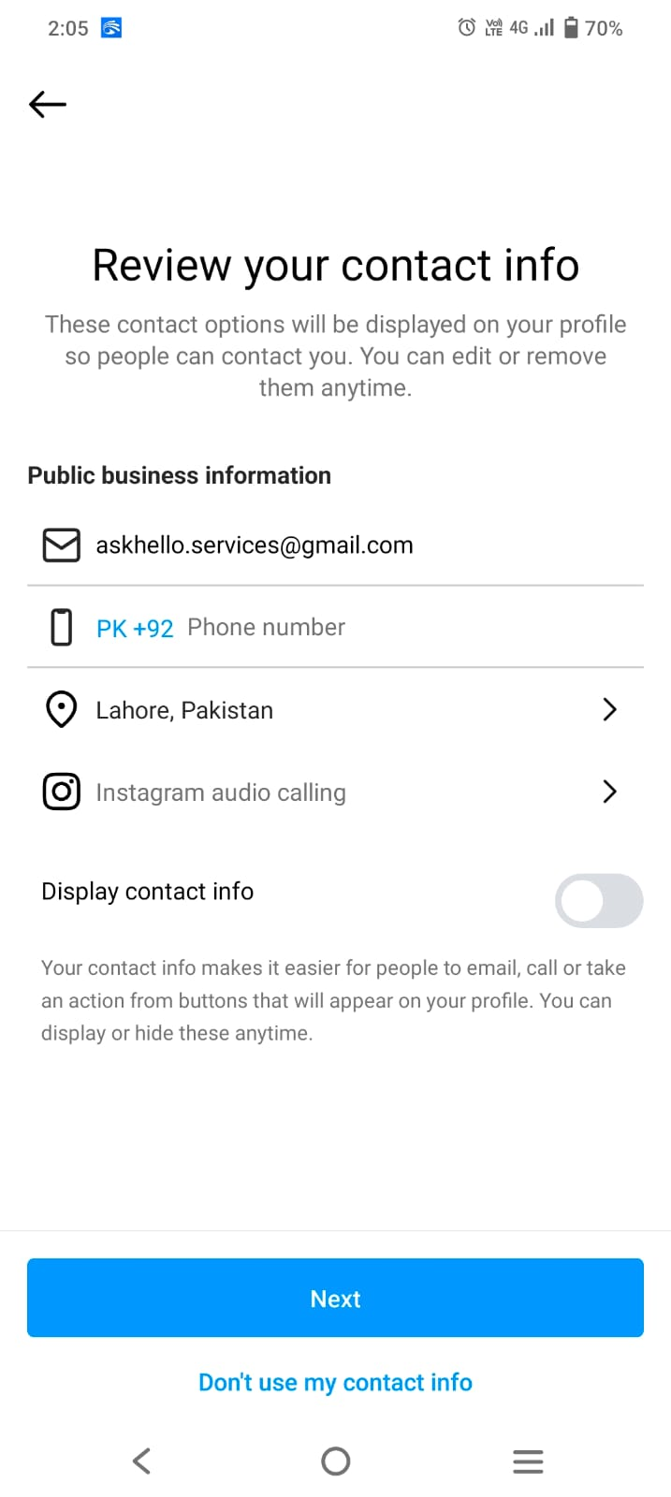

Slide 27
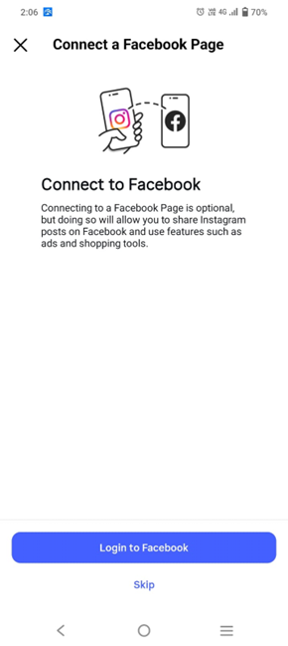
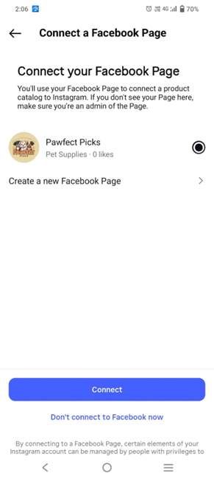
Link both accounts
Link Your Instagram to Your Facebook Page
Share posts across both
Manage everything via Meta Business Suite
Run ads in future

Slide 28
End of Lecture

